Slide 1

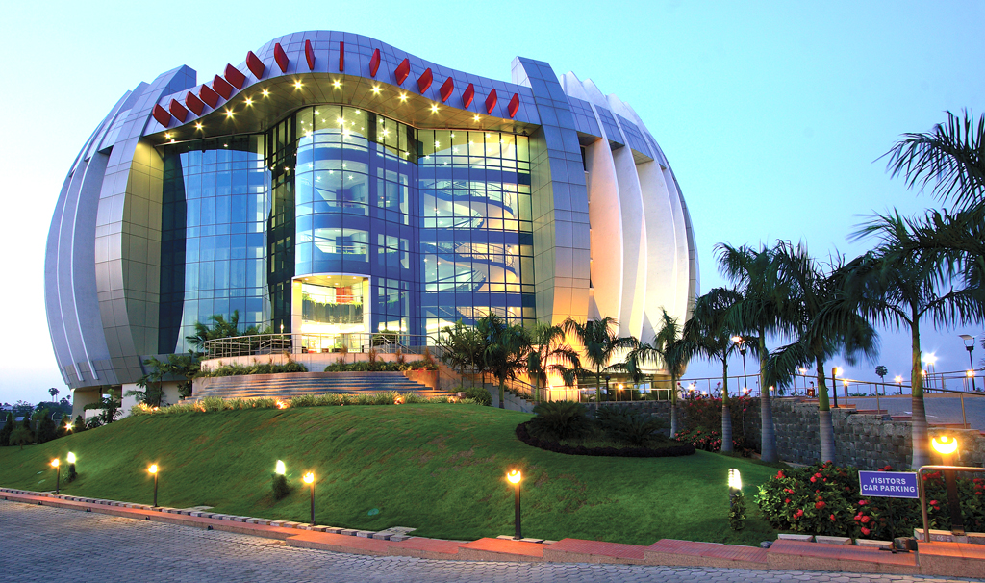
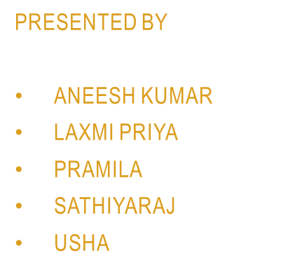
OUR 21 Days IN Amshuhu

Slide 2
First of all we learned how to assess ourselves personally as well as technically.
After attending communication classes we gained more self confidence and started speaking English with our colleagues.
The self assessment helped us to have a clear vision board for the next 2 years.
The general session help us to handle the stress and how to manage our stress at difficult situations.

Slide 3
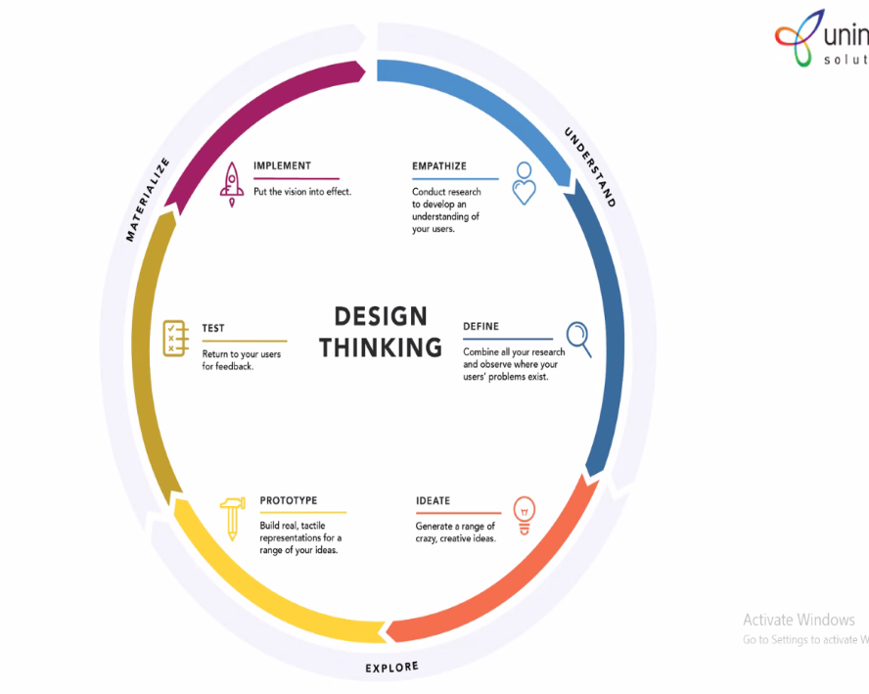
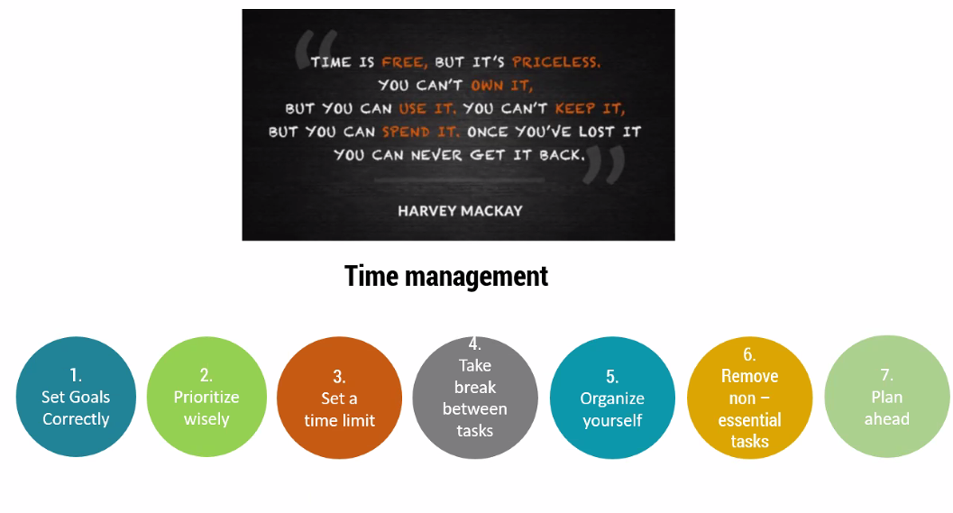
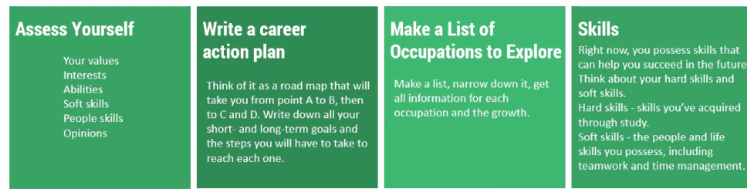
General session

Slide 4
We have fortified our knowledge in technical languages like HTML and CSS through Udemy platform.
We also learned how to cope up with our team mates in non-technical activities with the help of fun meetings on Saturdays which adds us an advantage like easily mingle with people .
We gained more knowledge in excel with the help of excel sessions.
By the help of technical classes, we got basic knowledge in many programming languages.
Playing games like SUDOKU and CHESS enhanced our thinking and problem solving ability.
We learned how to spend our time efficiently through this whole training sessions .

Slide 5

We feel proud to work for Amshuhu. Thank you for giving us this valuable opportunity. Definately, we will give our best by contributing to the symbolic growth of the organization in future.

